Slide 1
Toward SDN for Tactical Edge Networks Y. Richard Yang Yale University

Slide 2

What is SDN?
Separation of data and control paths
Logically centralized control plan
…
Notes:
Risk: having a narrowly defined hammer and looking for nails

Slide 3


A More General View of SDN: Programmable Networks
Same deployed asset
Programmability to
provide more functions
utilize asset more efficiently

Slide 4
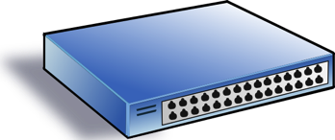
SDN Progress as Programmability Progress
Low-level Programming => High-level Programming
OpenFlow => P4/POF
Service/ Policy
Program Logic
Datapath Model/ Program
Datapath Model/ Program
Network State
Distributed Comp => Logically Centralized Comp

Slide 5
New Capabilities: High-level Network Programming Abstraction (Magellan)
Consider each pkt as a request
- Network as a single virtual server
- Network functions expressed in general purpose language
- Network functions (logically) invoked on each pkt, returning how net handles that request
- Intention returned to realization is opaque

Slide 6
Example Magellan Program
void f(Packet p) {
if ( !permit(p) ) p.route = null;
else {
EndpointProp sedp = hostTable(p.ipSrc());
EndpointProp dedp = hostTable(p.ipDst());
int rate = p.bitRate(); // protocol customizatiz.
QoSRoute qr = routingAlg(topology(), rate, sedp, dedp);
p.route = qr.route; p.rate = qr.rate;
}
}
QoSRoute routingAlg(Topology topo, int r, EndpointProp s, EndpointProp d) {
if ( allowedRate(s, d) < r ) // access control
r = allowedRate(s, d);
return QoSRouting(topo, s, d, r);
}
Notes:
relatively low rate, unreliable, nodes are highly mobile

Slide 7
Magellan Program to Command and Control
“Oracle” Program
DB
Compile
IR
Analyze&Optimize
Datapath Design
Code Gen
Offline
Rules
Batch Explorer
Net State
Update
onDemand Handler
Online
Network and Endhost Devices
Notes:
relatively low rate, unreliable, nodes are highly mobile

Slide 8
Challenges: What May a Tactical Network Break?
“Oracle” Program
DB
Compile
IR
Analyze&Optimize
Datapath Design
Code Gen
Offline
Rules
Batch Explorer
Net State
Update
onDemand Handler
Online
If Demand > Capacity => InControllability
Network and Endhost Devices
Notes:
relatively low rate, unreliable, nodes are highly mobile

Slide 9
From DC SDN to Tactical Edge SDN
Demand and capacity analysis and design for the network <-> controller channel
Increase capacity:
Controlled mobility
…
Decrease demand:
Degenerate to disconnected operation
Approximate/coarse-grained comput.
…

Slide 10
Summary
Protocol oblivious datapath and high-level SDN programming can lead to substantial flexibility and efficiency in network control and coordination
Key challenge in applying SDN to Tactical Edge is the network-controller channel

Slide 11
Backup Slides

Slide 12
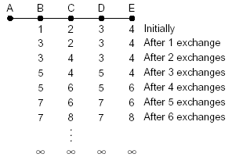
Why Logically Centralized Control?
Inconsistent state
Arrow’s Impossibility Theorem
Notes:
Inconsistent state is a key source of complexity

Slide 13
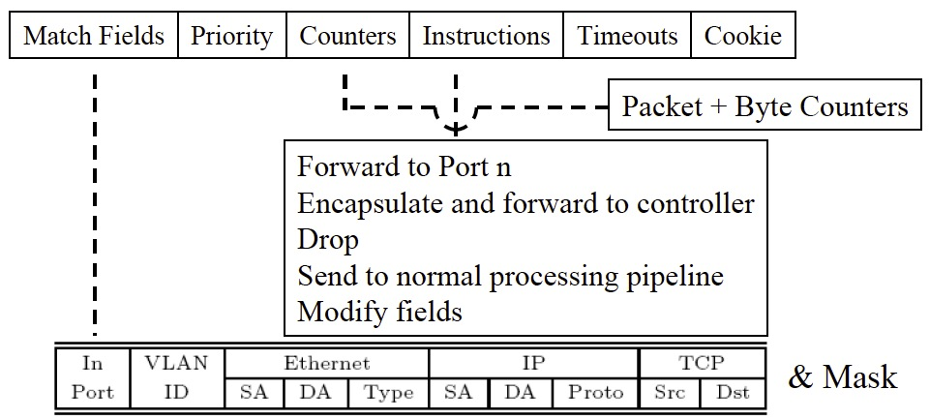
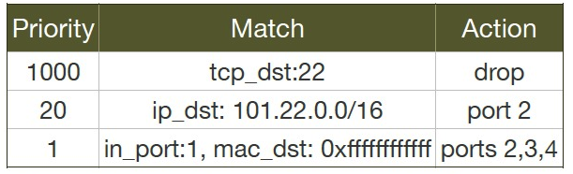
Data Path Abstraction (OpenFlow)

Slide 14
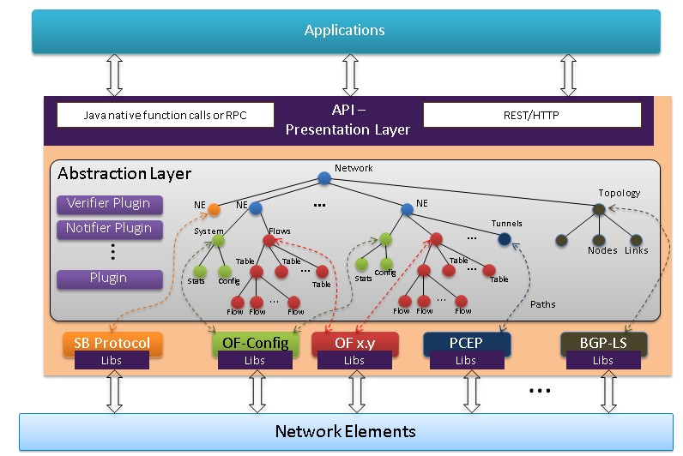
Data Store Abstraction (YANG)
https://wiki.opendaylight.org/view/OpenDaylight_Controller:Architectural_Framework

Slide 15
Network Forwarding as Caching Lookup
Central control function consists of a sequence of instructions I₁, I₂, …, I_{n}
Each instruction I is a mapping from input variable states to output variable states
InVar(I)₁ | InVar(I)₂ | InVar(I)₃ | OutVar(I)
1 | 1 | 1 | OutVar(I)=I(1,1,1)
…
…
InVar(I)1
I
OutVar(I)
InVar(I)2
InVar(I)3

